Slide 1

Project Non-GMO
Mike McCormick – Project Lead
Neil Carrico – Backend Database
James Scott – Backend Database
Bridger Lewis – Mobile Backend UI/UX

Slide 2
Background
GMOs (genetically modified organisms) are living organisms whose genetic material has been artificially manipulated in a laboratory through genetic engineering.
Packaging and labeling can be confusing or inaccurate.
Only private organizations currently verify Non-GMOs.
Notes:
Organic means you just don’t use pesticides or spray that harm the product. USDA regulates the testing and labeling of Organic. All Natural, No artificial ingredients.

Slide 3

Our Vision
Provide information on the products’ Non-GMO status
Enables the average consumer to make an immediate, educated decision
Keep the app quick and clean
Low tech user interface
Search competing prices
Enjoyable shopping experience
Notes:
1. Anyone that wants more information or make a decision right in the grocery store can do so
2. Fast is the key word.. We want our app to give really fast feedback and also allow users to navigate the app easily
3. Any user with a phone or tablet will be able to use the app, because we tried at all costs to make it as low tech as possible
4. Provide easy to understand information on the products in a way that you could find exactly what you want to know
5. Another goal will be that you can you use our app to search for competing prices in most grocery stores or supermarkets
6. OVERALL OUR GOAL = SHOPPER. Make it as enjoyable as we can for the user so they will want to come back and try it again

Slide 4




Categories
Manual Input
Scan
Google Vision API
Database
Non-GMO
GMO
Notes:
Why we chose Android. Why we chose SQlite and Vision API

Slide 5
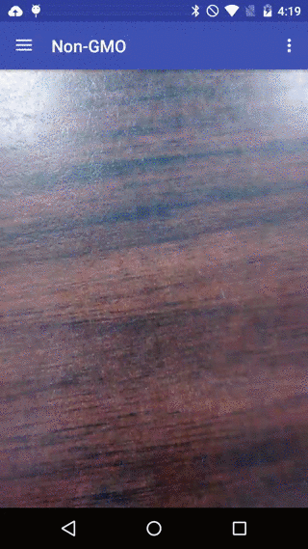

Slide 6
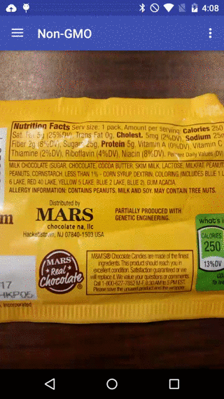
Notes:
You can even see on the M&M package that this product has been partially produced with genetic engineering.

Slide 7
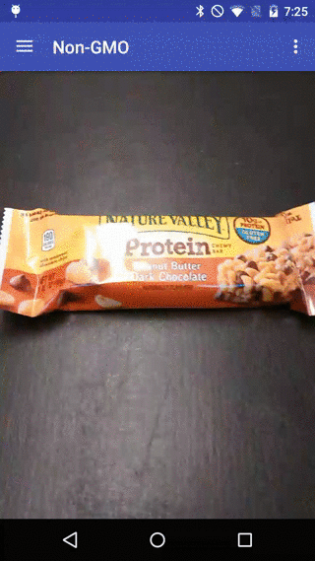
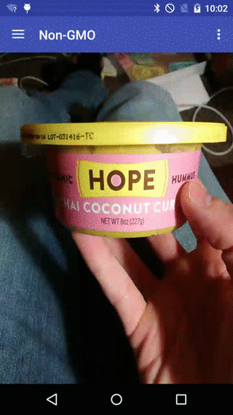

Slide 8
What we learned
Implementing a database into our application.
Partnering with nongmoproject.org had its own sets of challenges.
Balancing other class work with our senior design project.
Implementing the camera functions required learning Google API

Slide 9
Future goals of our app
Improve the User Interface
More in depth price comparison
Optimize the searching algorithm
Include knowledge of:
Organic
Ingredients ( aspartame, high fructose corn syrup, trans fat, etc.)
Allergens/Intolerances
Diet restrictions (Vegetarian, Vegan , Paleo, etc.)

Slide 10
Project Non-GMO
Production Launch: May 9th, 2016

Slide 11
Q
A
Q
A
Q
A
&
Q
A
&
&
&
Q
A
Q
A
&
&
Q
A
&
Q
A
Q
A
&
&
Q
A
&
Q
A
Q
A
&
&
Q
A
Q
A
&
&
Q
A
Q
A
&
&
Q
A
&
Q
A
Q
A
&
Q
A
&
Q
A
&
&

